Slide 1
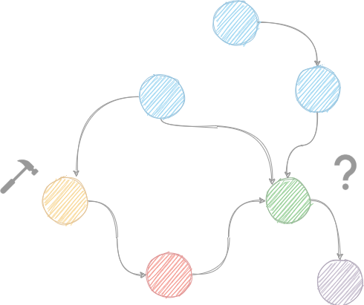
Introduction
Motivation
Causality
Methods
Metrics
Conclusion
Machine Learning for Causal Inference from Observational Data
Damian Machlanski d.machlanski@essex.ac.uk
CSEE and MiSoC, University of Essex
July 28th 2022

Slide 2
Introduction
Motivation
Causality
Methods
Metrics
Conclusion
Introduction
Motivation
Causality
Methods
Metrics
Conclusion

Slide 3
Introduction
Motivation
Causality
Methods
Metrics
Conclusion
Welcome!
Agenda
Slides: Introduction to Causal Inference
Tutorial: Guided Example with Code
Exercise: Do It Yourself
With some breaks in the middle as necessary.

Slide 4
Introduction
Motivation
Causality
Methods
Metrics
Conclusion
Resources
Textbooks
J. Pearl and D. Mackenzie, The Book of Why: The New Science of Cause and Effect, 1st ed. USA: Basic Books, Inc., 2018.¹
J. Pearl, M. Glymour, and N. P. Jewell, Causal Inference in Statistics: A Primer. John Wiley & Sons, 2016.²
J. Peters, D. Janzing, and B. Scholkopf, Elements of Causal Inference: Foundations
and Learning Algorithms. The MIT Press, 2017.³
Online
Introduction to Causal Inference⁴ (video courses)
¹http://bayes.cs.ucla.edu/WHY/ ²http://bayes.cs.ucla.edu/PRIMER/ ³https://mitpress.mit.edu/books/elements-causal-inference ⁴https://www.bradyneal.com/causal-inference-course

Slide 5
Introduction
Motivation
Causality
Methods
Metrics
Conclusion
Tools
We are going to use the following:
Python 3
scikit-learn (ML methods)
EconML⁵ (CI estimators)
The usual ML stack (numpy, pandas, matplotlib)
Google Colab
⁵https://github.com/microsoft/EconML

Slide 6
Introduction
Motivation
Causality
Methods
Metrics
Conclusion
A Machine Learning Perspective
We will need the following:
Supervised learning - predict y given (X, y) samples
Regression (continuous outcome)
Classification (binary outcome)
Basic data exploration
Data pre-processing
Training and testing
Using metrics
You probably know all this by now -> we can do causal inference!

Slide 7
Introduction
Motivation
Causality
Methods
Metrics
Conclusion
Summary
Causal inference is about estimating causal effects
For instance, measure the effectiveness of a treatment
RCTs are the most reliable source of data, but can be unfeasible to obtain
Non-experimental data are a great alternative, but can be biased
Most methods are about finding unbiased estimators
Machine Learning and Causal Inference can be both mutually beneficial
ML delivers better CI estimators
CI helps ML with OOD generalisation
Assumptions and graphs are important and must be considered in applications

Slide 8
Introduction
Motivation
Causality
Methods
Metrics
Conclusion
Why Do I Need This?
Data science is more than just ML
It’s about decision making -> most all methods = to advice us in making decisions especially making them informed and with
certainty/confidence
Associations vs. causal relations -> relate to that certainty of making decisions
Correlation does not imply causation
Also: biases and shifts within the data that skew the results
Wrong conclusions -> bad decisions
Complimentary to permutation tests:
PT: Is the effect statistically significant? (yes/no)
CI: How big the effect is? (number) (= Causal inference not confidence interval)

Slide 9
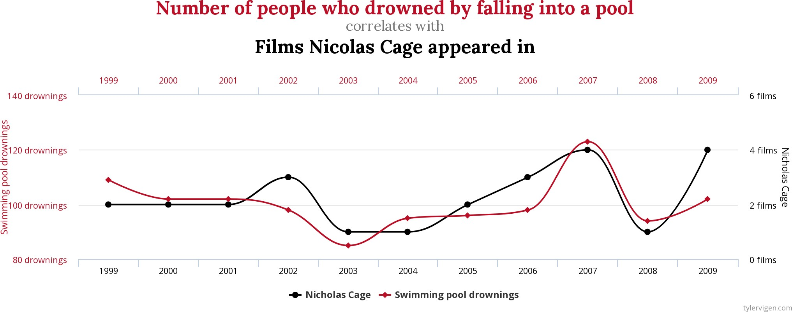
Introduction
Motivation
Causality
Methods
Metrics
Conclusion
Spurious Correlations
Credit: https://www.tylervigen.com/spurious-correlations

Slide 10
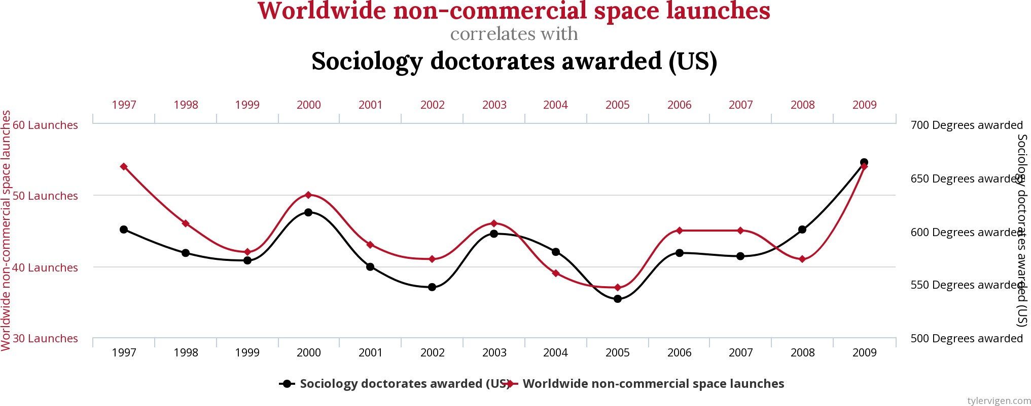
Introduction
Motivation
Causality
Methods
Metrics
Conclusion
Spurious Correlations (2)
Credit: https://www.tylervigen.com/spurious-correlations

Slide 11
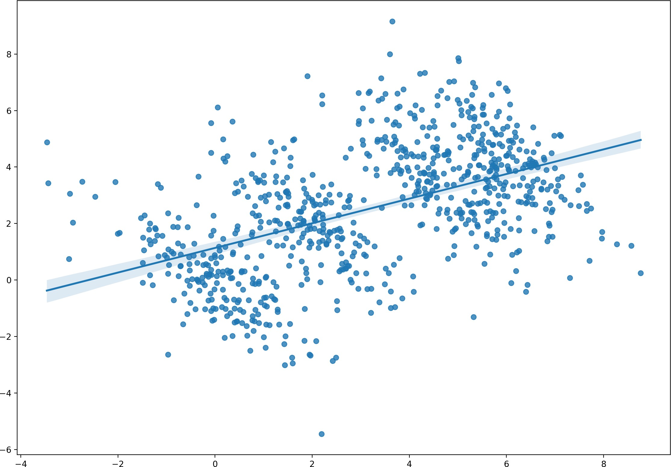
Introduction
Motivation
Causality
Methods
Metrics
Conclusion
Simpson’s Paradox

Slide 12
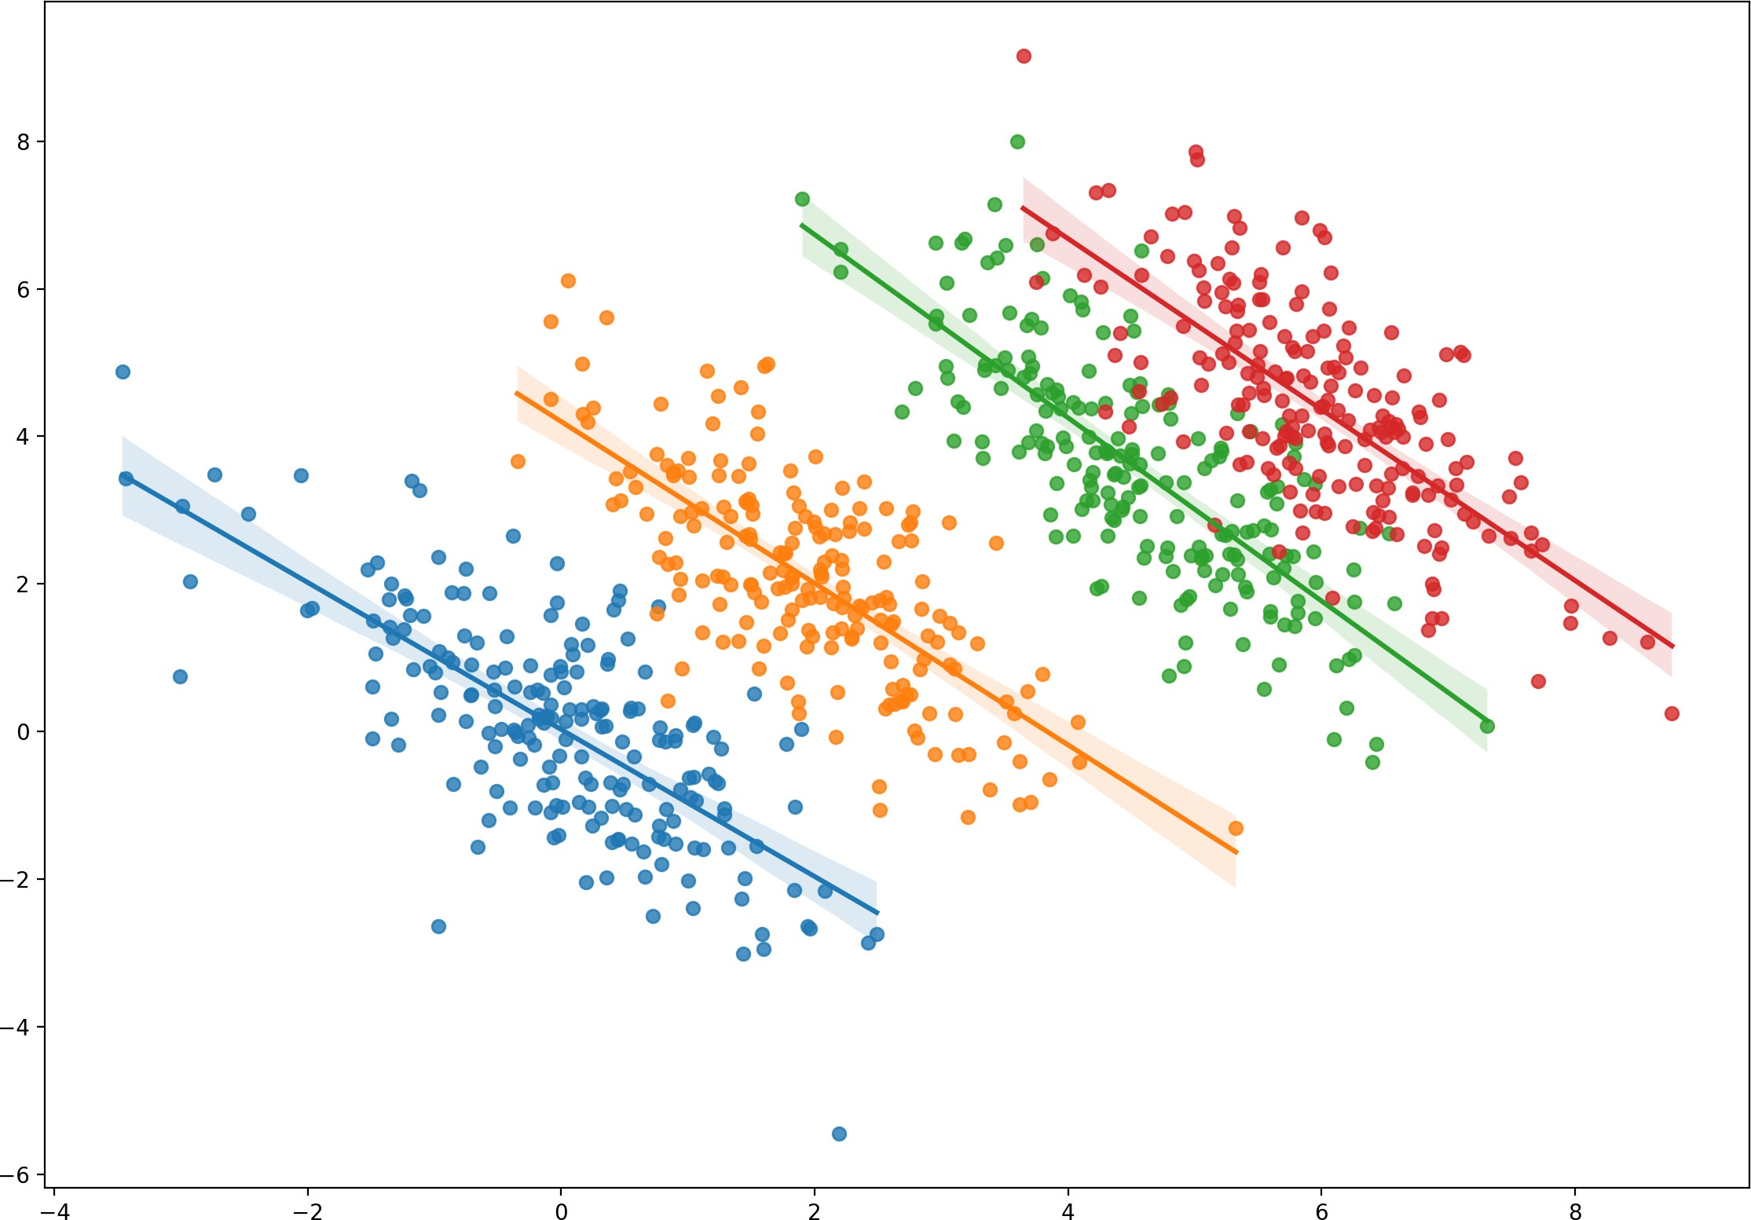
Introduction
Motivation
Causality
Methods
Metrics
Conclusion
Simpson’s Paradox

Slide 13
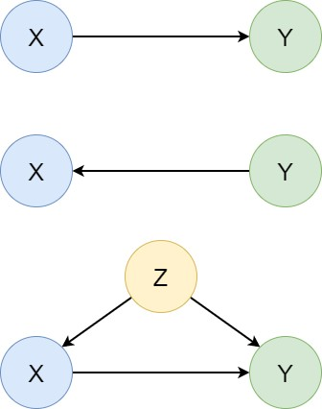
Introduction
Motivation
Causality
Methods
Metrics
Conclusion
Takeaway
We need to think about the causal links within the data (causal graphs).
Cause and effect
Question: As we change the cause, how does the effect change?

Slide 14
Introduction
Motivation
Causality
Methods
Metrics
Conclusion
Problem Setting
We want to estimate the causal effect of treatment T on outcome Y
What benefits accrue if we intervene to change T ?
Treatment must be modifiable
We observe only one outcome per each individual
Ideal scenario:
Assume state S₀
Apply the treatment (t = 1)
Observe the outcome (Y₁)
Reset the state to S₀ (steps 2. and 3. didn’t happen)
Do not apply the treatment (t = 0)
Observe the outcome (Y₀)
Compare the outcomes Y₁ and Y₀ to get the causal effect

Slide 15
Introduction
Motivation
Causality
Methods
Metrics
Conclusion
Real-life Example
My headache went away after I had taken the aspirin (Y₁)
Would the headache have gone away without taking the aspirin? (Y₀ =?)
We cannot go back in time and test the alternative!
Cannot reset the state -> cannot compare the outcomes -> no effect
Test more people and measure the average outcome?

Slide 16
Introduction
Motivation
Causality
Methods
Metrics
Conclusion
More Examples
Developing a new vaccine
Government policy
Recommending the best treatment for a specific patient
It’s about finding out how a specific action affects a system of interest.
Action == intervention (something we change)
System == the very thing we study (group of people, physical objects, etc.)
Outcome == system’s characteristic of interest (response)
Effect == difference between outcomes
Is this the ML perspective?

Slide 17
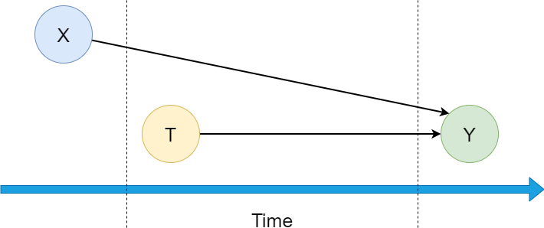
Introduction
Motivation
Causality
Methods
Metrics
Conclusion
Randomised Controlled Trials
Outcome = Data from controlled experiments
Randomised T = people randomly assigned T = 0 (control) or T = 1 (treated)
This mimicks observing alternative reality
Record background characteristics as X = [X₁, X₂, ..., X_{n}]
Can be expensive or even unfeasible (e.g. smoking)
Record characteristics (weight, height, gender..) before treatment
Record outcome variable of interest = effect treatment
Apply treatment

Slide 18
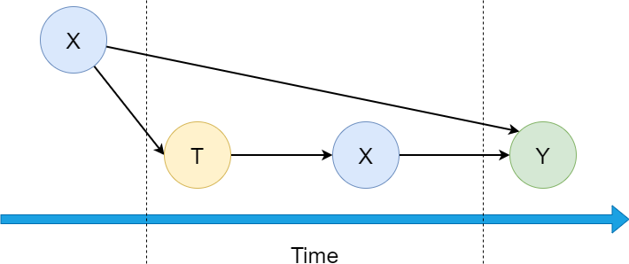
Introduction
Motivation
Causality
Methods
Metrics
Conclusion
Observational Data
Passively collected data (non-experimental)
Abundant nowadays (every platform you are on online ever)
Quasi-experimental study
Keep only X recorded before Y (discard other) (? i.e., keep bot Xa and Xb but discard an after Y Xc? Or did you mean T instead of Y and thus only keep Xa )
Lack of randomisation and control (imbalances)
a
b

Slide 19
Introduction
Motivation
Causality
Methods
Metrics
Conclusion
ML Perspective
Outliers are important for Machine learning? Why? Did not follow explanation. My psychology mind cannot compute.
(means = noise that helps with generalisation?)
See biased estimators slide 35
apparently noise/outlier not good for ML, but should be considered to hold value for CI??
Imbalance in Y = not equal nr of people in each outcome condition.
+ No control, potential little overlap between groups (i.e., little base to say ‘only difference is T’ ) = Imbalance of features.
Generalisation -> an algorithm that works on different data sets AND different domains (e.g., not just good at one game, but just at playing multiple games..)
Correlation vs. causation
Outliers - different meaning (?)
Imbalanced data (not just Y)
Out-of-distribution (OOD) generalisation
ML vs. CI:
ML: predict Y given (X, Y) samples
CI: predict effects given (X, Y) samples ci = causal inference

Slide 20
Introduction
Motivation
Causality
Methods
Metrics
Conclusion
More on ML vs. CI
ML
Train on (X, Y) samples
Predict Y given X test samples
Assumes the same distribution of training and testing samples
Same distribution = Independent and identically distributed (IID)
[ see notes below]
CI
Train on (X, T, Y) samples
Predict Y for (X, T) and (X, 1-T)
(X, 1-T): predict the outcomes we haven’t observed
Treated (t = 1) and control (t = 0) groups often have different distributions
We learn from one distribution, but make predictions for a different one!
The usual IID assumption no longer applies here
Notes:
A random variable is variable which contains the probability of all possible events in a scenario.
For example, lets create a random variable which represents the number of heads in 100 coin tosses (so not the coin tosses it self, the variable is the nr of heads in a certain nr of coin tosses). The random variable will contain the probability of getting 1 heads, 2 heads, 3 heads.....all the way to 100 heads. Lets call this random variable X.
If you have two random variables then they are IID (independent identically distributed) if:
If they are independent.
Independence means the occurrence of one event does not provide any information about the other event. For example, if I get 100 heads after 100 flips, the probabilities of getting heads or tails in the next flip are the same. Similarly to a dice role, getting a certain nr in the next role = always the same
If each random variable shares the same distribution. For example, lets take the random variable from above - X. Lets say X represents Obama about to flip a coin 100 times. Now let's say Y represents a Priest about to flip a coin 100 times. If Obama and the Priest flip coins with the same probability of landing on heads, then X and Y are considered identically distributed. If we sample repeatedly from either the Priest or Obama, then the samples are considered identically distributed.
Side note: Independence also means you can multiply probabilities. Lets say the probability of heads is p, then the probability of getting two heads in a row is p*p, or p^2.
identical distribution refers to the entire probability distribution, whereas equal probability refers to parts of that probability distribution.
i.e., assuming every coin has the same probability of 50/50 -> a coin A and a coin B tossed a 100 times = identical distribution of probability of nr of heads thrown in a 100 flips

Slide 21
Introduction
Motivation
Causality
Methods
Metrics
Conclusion
Fundamentals
Effect = Y₁ − Y₀
# X₁ X₂ X₃ T Y₀ Y₁
1 1.397 0.996 0 1 ? 4.771
2 0.269 0.196 1 0 2.956 ?
3 1.051 1.795 1 1 ? 4.164
4 0.662 0.196 0 1 ? 6.172
5 0.856 1.795 1 0 7.834 ?
Observed and unobserved outcomes are factuals and counterfactuals respectively.
Missing counterfactuals: This is known as the fundamental problem of causal inference. We cannot observe the difference, but we can approximate it.

Slide 22
Introduction
Motivation
Causality
Methods
Metrics
Conclusion
Treatment Effect
(i)
Let us define the true outcome Y of individual (
i) that received treatment t ∈ {
0, 1}.
t
The Individual Treatment Effect (ITE) is then defined as follows:
(i)
(i) (i)
ITE = Y − Y
1 0
The Average Treatment Effect (ATE) builds on ITE:
ATE = E[ITE]
Note: empirical (sample) ATE is the mean of ITEs.

Slide 23
Introduction
Motivation
Causality
Methods
Metrics
Conclusion
Treatment Effect - ITE Example
We are given the outcomes Y for both the treated (t = 1) and control (t = 0) case, where Y₁ = 3 and Y₀ = 2.
What is the value of ITE?

Slide 24
Introduction
Motivation
Causality
Methods
Metrics
Conclusion
Treatment Effect - ITE Example (2)
We are given the outcomes Y for both the treated (t = 1) and control (t = 0) case, where Y₁ = 3 and Y₀ = 2.
What is the value of ITE?
(i)
(i)
(i)
ITE = Y − Y
1
0
ITE = 3 − 2 = 1

Slide 25
Introduction
Motivation
Causality
Methods
Metrics
Conclusion
Treatment Effect - ATE Example
We are given the following data:
Y₀ ∈ {2, 3, 1}
Y₁ ∈ {3, 4, 2}
What is the value of ATE?

Slide 26
Introduction
Motivation
Causality
Methods
Metrics
Conclusion
Treatment Effect - ATE Example (2)
We are given the following data:
Y₀ ∈ {2, 3, 1}
Y₁ ∈ {3, 4, 2}
What is the value of ATE?
ATE = E[ITE]
ITE⁽⁰⁾ = 3 − 2 = 1
ITE⁽¹⁾ = 4 − 3 = 1
ITE⁽²⁾ = 2 − 1 = 1
ITE⁽⁰⁾ + ITE⁽¹⁾ + ITE⁽²⁾ 1 + 1 + 1 3
3 3
ATE =
=
= ₃ = 1

Slide 27
Introduction
Motivation
Causality
Methods
Metrics
Conclusion
Treatment Effect - CATE
A more general way of defining effects is through conditioning:
CATE = E [Y₁|X = x] − E [Y₀|X = x]
Which stands for Conditional Average Treatment Effect.
Note the two previous effects are special cases of CATE (ATE: x = ∅, ITE: unique x). You will likely see CATE estimators in the literature and CI packages.

Slide 28
Introduction
Motivation
Causality
Methods
Metrics
Conclusion
Assumptions
Ignorability:
No hidden confounders (we observe everything)
All background covariates X happened before the outcome Y see next slide, implies they assume x influences treatment as much as the outcome
Modifiable treatment T
Stable Unit Treatment Value Assumption (SUTVA):
No interference between units
Consistent treatment (different versions disallowed)

Slide 29
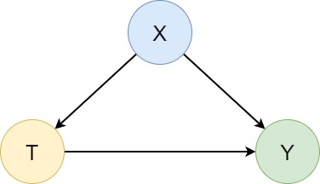
Introduction
Motivation
Causality
Methods
Metrics
Conclusion
Assumptions (2)
Most CI estimators assume the triangle graph
This is a very simplistic view of the world
Actual reality can be much more complex

Slide 30
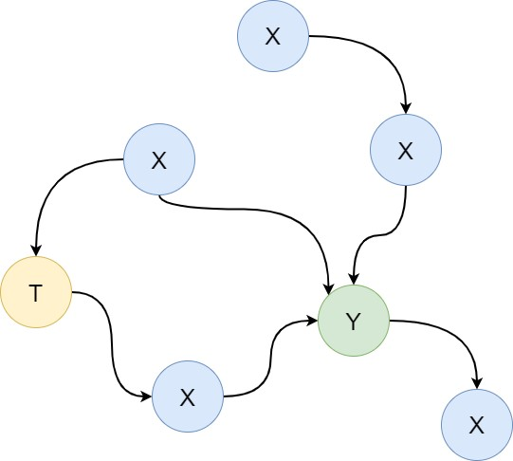
Introduction
Motivation
Causality
Methods
Metrics
Conclusion
Assumptions (3)
Can we infer graphs from data?
Causal discovery

Slide 31
Introduction
Motivation
Causality
Methods
Metrics
Conclusion
Onto The Methods
We know the theory. Now, let’s do some modelling!

Slide 32
Modern Approaches
Introduction Motivation Causality Methods Metrics Conclusion
Mosty regression and classification (classic ML), but combined in a smart way.
Recent surveys on modern causal inference methods ⁶ ⁷
Most popular:
Inverse Propensity Weighting (IPW)
Doubly-Robust
Double/Debiased Machine Learning
Causal Forests
Meta-Learners
Multiple based on neural networks (very advanced)
Too many to discuss here, but we will learn some common principles.
We will start with a simple regression, add IPW, and conclude with Meta-Learners.
⁶https://dl.acm.org/doi/10.1145/3397269 ⁷https://arxiv.org/abs/2002.02770

Slide 33
Introduction Motivation
S-Learner https://statisticaloddsandends.wordpress.com/2022/05/20/t-learners-s-learners-and-x-learners/
We want to estimate
Causality
Methods
Metrics
Conclusion
µ(t, x) = E[Y|X = x, T = t]
Obtain µˆ(t, x) estimator.
Predict ITE as
I^T E(x) = µˆ(1, x) − µˆ(0, x)
Single model approach
Allows heterogenous treatment effects -> i.e., identify effects from different treatments
Can be biased (next slide)

Slide 34
Introduction
Motivation
Causality
Methods
Metrics
Conclusion
S-Learner - Code
lr = LinearRegression()
# input: [X, T], target: Y
lr.fit(np.concatenate([x_train, t_train], axis=1), y_train)
# predict Y0 given [X, 0] - set T=0
y0_pred = lr.predict(np.concatenate([x_test, np.zeros_like(t_test)], axis=1))
# predict Y1 given [X, 1] - set T=1
y1_pred = lr.predict(np.concatenate([x_test, np.ones_like(t_test)], axis=1))
# effect = y1 - y0
effect_pred = y1_pred - y0_pred

Slide 35
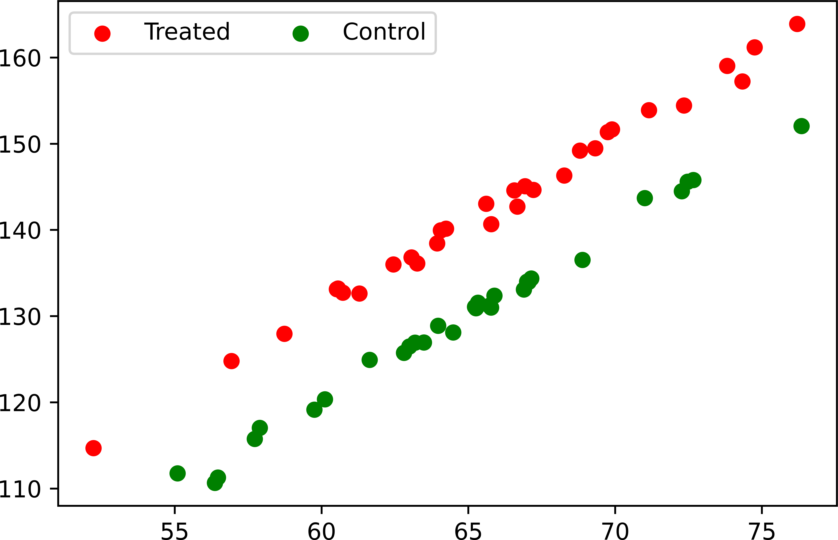
Introduction
Motivation
Causality
Methods
Metrics
Conclusion
When It Works

Slide 36
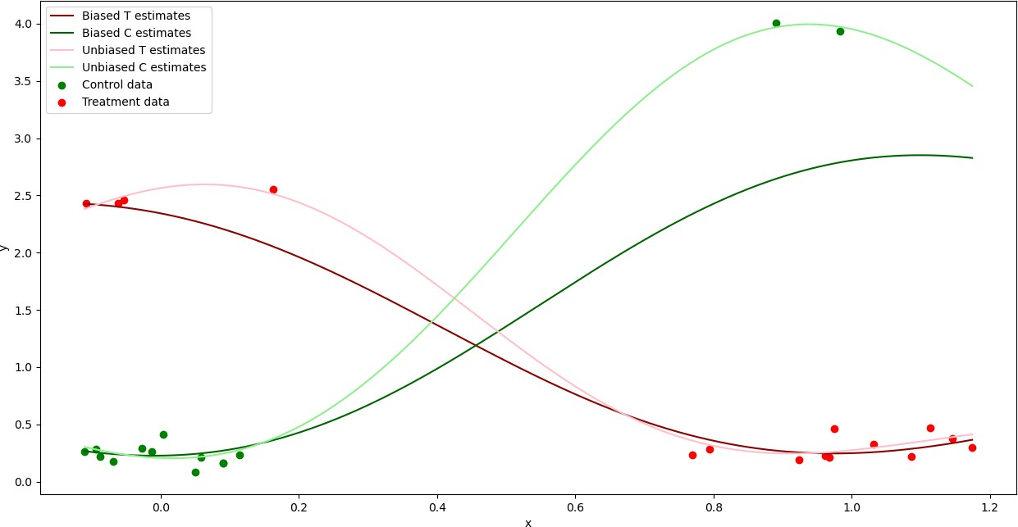
Introduction
Motivation
Causality
Methods
Metrics
Conclusion
Biased Estimators
Notes:
= due to outliers.
Teach claims we should handle those data points as valid and true data points. = will change your estimates and model.
Especially in causal experimental settings. Data more likely to hold true and not being an outlier.
Observational not so much, many things could have influenced your output.

Slide 37
Introduction
Motivation
Causality
Methods
Metrics
Conclusion
Propensity Score = what you can use to counter the bias
A propensity score is the probability of a unit (e.g., person, classroom, school) being assigned to a particular treatment given a set of observed covariates. Propensity scores are used to reduce selection bias by equating groups based on these covariates.
e(x) = P (t_{i} = 1|x_{i} = x)
Probability of a unit i receiving the treatment (T = 1)
For discrete treatments, this is a classification problem
Binary classification in most cases as t ∈ {0, 1}
We denote eˆ(x) as our estimation
These propensity scores are then used as estimators for weights to be used with Inverse probability weighting methods. (next slide) -> Weighting, when correctly applied, can potentially improve the efficiency and reduce the bias of unweighted estimators. e.g., the model having a bias to the ‘treatment condition’

Slide 38
Introduction
Motivation
Causality
Methods
Metrics
Conclusion
IPW Estimator (see notes below)
Using the propensity score eˆ(x), we can obtain the following weights
t_{i} 1 − t_{i}
w_{i} =
+
eˆ(x_{i}) 1 − eˆ(x_{i})
These are called Inverse Propensity Weights (IPW)
Use the weights to perform weighted regression -> how much influence a certain data point will have
Similar to S-Learner, but combines regression and classification
Sample importance (pay attention to scarce data points)
Either eˆ(x) or µˆ(x) can still have bias (misspecification)
Doubly-Robust method attempts to address that
Notes:
https://en.wikipedia.org/wiki/Inverse_probability_weighting
The inverse probability weighting estimator can be used to demonstrate causality when the researcher cannot conduct a controlled experiment but has observed data to model. Because it is assumed that the treatment is not randomly assigned, the goal is to estimate the counterfactual or potential outcome if all subjects in population were assigned either treatment.
Inverse probability weighting is also used to account for missing data when subjects with missing data cannot be included in the primary analysis. With an estimate of the sampling probability, or the probability that the factor would be measured in another measurement, inverse probability weighting can be used to inflate the weight for subjects who are under-represented due to a large degree of missing data.
In the case here, can also be used to ‘ fight against outliers’ = in either way. If you believe the ‘ extreme points’ are valid, but just an under representation of a certain group B (e.g., observed data thing above) -> we can increase their weight by estimating what stuff would look like if all pp from A were assigned to B.
On the other hand, can use it to fight against actual outliers that are not legit data points, but don’t want to remove their information = make them have less weight.

Slide 39
Introduction
Motivation
Causality
Methods
Metrics
Conclusion
IPW Estimator - Code
clf = LogisticRegression()
weights = get_ps_weights(clf, x_train, t_train)
lr = LinearRegression()
# input: [X, T], target: Y
lr.fit(np.concatenate([x_train, t_train], axis=1), y_train, sample_weight=weights)
# ...

Slide 40
Introduction
Motivation
Causality
Methods
Metrics
Conclusion
T-Learner (see link s learner)
Treated and control distributions are often different
Solution: fit two separate regressors
µ₁(x) = E[Y|X = x, T = 1]
µ₀(x) = E[Y|X = x, T = 0]
Learn µ₁(x) from treated units, obtain µˆ₁(x).
Learn µ₀(x) from control units, obtain µˆ₀(x).
Predict ITE as
I^T E(x) = µˆ₁(x) − µˆ₀(x)

Slide 41
Introduction
Motivation
Causality
Methods
Metrics
Conclusion
T-Learner - Code
m0 = LinearRegression() m1 = LinearRegression()
t0_idx = (t_train == 0).flatten() t1_idx = (t_train == 1).flatten()
# train on control units m0.fit(x_train[t0_idx], y_train[t0_idx]) # train on treated units m1.fit(x_train[t1_idx], y_train[t1_idx])
y0_pred = m0.predict(x_test) y1_pred = m1.predict(x_test)
effect_pred = y1_pred - y0_pred

Slide 42
Introduction
Motivation
Causality
Methods
Metrics
Conclusion
T-Learner - Code (2)
tl = TLearner(models=LinearRegression())
tl.fit(y_train, t_train, X=x_train) effect_pred = tl.effect(x_test)

Slide 43
Introduction
Motivation
Causality
Methods
Metrics
Conclusion
Learner
A hybrid of the previous approaches (details here⁸). There are three main stages.
Learn treated and control separately (same as T-Learner).
Predict and learn imputed effects (mix of Y_{f} and Y_{cf} ).
Learn a propensity score function.
The final treatment effect estimate is a weighted average of the two estimates from Stage 2:
τˆ(x) = eˆ(x)τˆ₀(x) + (1 − eˆ(x))τˆ₁(x)
⁸http://arxiv.org/abs/1706.03461

Slide 44
Introduction
Motivation
Causality
Methods
Metrics
Conclusion
X-Learner - Code
xl = XLearner(models=LinearRegression(), propensity_model=LogisticRegression())
xl.fit(y_train, t_train, X=x_train) effect_pred = xl.effect(x_test)

Slide 45
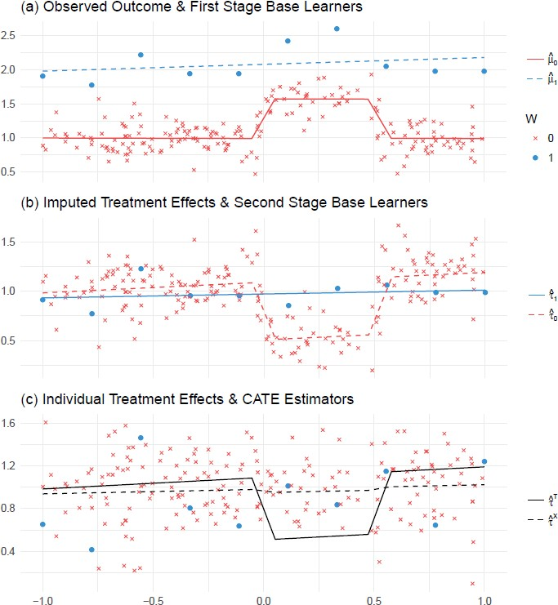
Introduction
Motivation
Causality
Methods
Metrics
Conclusion
X-Learner - Intuition

Slide 46
Introduction
Motivation
Causality
Methods
Metrics
Conclusion
Evaluation
We have predicted some effects.
But are they accurate?
How good our model is at predicting effects?
Can we use the usual metrics like MSE? -> mean square error see next two slides, yes, you can use MSE but does it tell the whole story?

Slide 47
Introduction
Motivation
Causality
Methods
Metrics
Conclusion
MSE
train test
1.6
1.4
1.2
1.0
Loss
0.8
0.6
0.4
0.2
0
20
40
epochs
60
80
100

Slide 48
Introduction
Motivation
Causality
Methods
Metrics
Conclusion
Policy Risk = Rpol next slide?
train test
0.30
0.28
0.26
policy
0.24
0.22
0.20
0
20
40
epochs
60
80
100

Slide 49
Introduction
Motivation
Causality
Methods
Metrics
Conclusion
Error On Outcomes vs. Effects
Predicting accurate outcomes Y (MSE) is only half of the problem
However, the priority is to predict accurate effects
Thus, we need to measure the amount of error (ϵ) or risk (R) introduced by a model with respect to predicted effects
Examples:
ϵAT E
ϵPEHE
ϵAT T
^{R}pol

Slide 50
Introduction
Motivation
Causality
Methods
Metrics
Conclusion
Predictions
(i)
Let us denote yˆ as predicted outcome for individual (
i) that received treatment t.
t
Then, our predicted ITE and ATE can be written as:
^
(i)
(i)
(i)
IT E = yˆ − y
ˆ
1 0
n
1
Σ
(i)
^
^
AT E =
IT E
^{n} i=1

Slide 51
Introduction
Motivation
Causality
Methods
Metrics
Conclusion
Measuring Errors
This allows us to define the following measurement errors (assuming you have access to the true effects, e.g., previous experiments, see next slide):
,
n
u
1
Σ
(i)
ϵ
=
,
( )₎2
PEHE
(I^T E − ITE ^{i}
^{n} i=1
ϵ_{AT E} = A^T E − ATE
Where PEHE stands for Precision in Estimation of Heterogeneous Effect, and which essentially is a Root Mean Squared Error (RMSE) between predicted and true ITEs.

Slide 52
Introduction
Motivation
Causality
Methods
Metrics
Conclusion
Benchmark Datasets
Semi-simulated data or combinations of experimental and observaional datasets. We use metrics depending on what kind of information we have access to (true effects/counterfactuals).
The main purpose is to test performance of causal estimators. The focus is on methods, not data.
Some well-established causal inference datasets:
IHDP
Jobs
News
Twins
ACIC challenges

Slide 53
Introduction
Motivation
Causality
Methods
Metrics
Conclusion
Types Of Metrics
If you can, calculate metrics on left.
But if you don’t have that ‘ factual knowledge’ go with right
With effect/counterfactuals
ϵAT E
ϵPEHE
Datasets with simulated outcomes
(it’s unnatural to observe both outcomes!)
Without effect/counterfactuals
ϵ_{AT T} (ATE on the Treated)
R_{pol} (Policy Risk)
Datasets closer to reality
Either purely observational or mixed with RCTs

Slide 54
Introduction
Motivation
Causality
Methods
Metrics
Conclusion
There Is More
We just scratched the surface here
Causal discovery (inferring graphs from data) - big topic on its own
Estimating causal effects vs. recommending treatments⁹
Other methods
Instrumental variables
Relaxing the common assumptions
Trees, neural networks, policy learners
Front-door and back-door adjustments
Handling colliders, confounders, feature selection
. . .
⁹http://arxiv.org/abs/2104.04103

Slide 55
Introduction
Motivation
Causality
Methods
Metrics
Conclusion
Acknowledgements
This lecture builds heavily on the materials from Introduction to Machine Learning for Causal Analysis Using Observational Data online course, delivered on June 22-23 2021 by Damian Machlanski, Dr Spyros Samothrakis and Professor Paul Clarke.

Slide 56
Introduction
Motivation
Causality
Methods
Metrics
Conclusion
References
J. M. Robins, A. Rotnitzky, and L. P. Zhao, ‘Estimation of Regression Coefficients When Some Regressors are not Always Observed’, Journal of the American Statistical Association, vol. 89, no. 427, pp. 846–866, Sep. 1994.
U. Shalit, F. D. Johansson, and D. Sontag, ‘Estimating individual treatment effect: generalization bounds and algorithms’, in International Conference on Machine Learning, Jul. 2017,
pp. 3076–3085.
V. Chernozhukov et al., ‘Double/debiased machine learning for treatment and structural parameters’, The Econometrics Journal, vol. 21, no. 1, pp. C1–C68, Feb. 2018.
S. Wager and S. Athey, ‘Estimation and Inference of Heterogeneous Treatment Effects using Random Forests’, Journal of the American Statistical Association, vol. 113, no. 523,
pp. 1228–1242, Jul. 2018.
S. R. Künzel, J. S. Sekhon, P. J. Bickel, and B. Yu, ‘Meta-learners for Estimating Heterogeneous Treatment Effects using Machine Learning’, Proc Natl Acad Sci USA, vol. 116, no. 10,
pp. 4156–4165, Mar. 2019.
R. Guo, L. Cheng, J. Li, P. R. Hahn, and H. Liu, ‘A Survey of Learning Causality with Data: Problems and Methods’, ACM Comput. Surv., vol. 53, no. 4, p. 75:1-75:37, Jul. 2020.
L. Yao, Z. Chu, S. Li, Y. Li, J. Gao, and A. Zhang, ‘A Survey on Causal Inference’, arXiv:2002.02770 [cs, stat], Feb. 2020.

Slide 57
Introduction
Motivation
Causality
Methods
Metrics
Conclusion
What’s next?
Onto the practical parts
Tutorial
Predict ATE and measure gATE
S-Learner, IPW and X-Learner
Random Forest as base regressors and classifiers
Exercise - IHDP
Predict ITE and ATE
Measure gPEHE and gATE
Exercise - JOBS (optional)
Predict ATT and Policy
Measure gATT and Rpol
Short break?

